Slide 1
Rockbuster Stealth Data Analysis Project
Emmanuel Eniade

Slide 2
Introduction
Rockbuster Stealth LLC is a movie rental company that used to have stores around the world. Facing stiff competition from streaming services such as Netflix and Amazon Prime, the Rockbuster Stealth management team is planning to use its existing movie licenses to launch an online video rental service in order to stay competitive.

Slide 3
Project Objective
To help Rockbuster understand the launch strategy for the new online video service.
To help Rockbuster understands how to deal with the stiff competition from streaming services with other providers.

Slide 4
Key questions:
Which movies contributed the most/least to revenue gain?
What was the average rental duration for all videos?
Which countries are Rockbuster customers based in?
Where are customers with a high lifetime value based?
Do sales figures vary between geographic regions?

Slide 5
Findings & Insights

Slide 6
which movies contributed the most to revenue gain
Movies with most revenue are: Telegraph Voyage, Zorro Ark, Wife Turn, Innocent Usual, Hussler Party
Telegraph voyage
Zorro Ark
Wife turn
Innocent Usual
Hussler Party
$216
$200
$199
$192
$191

Slide 7
Which movies contributed the least to revenue gain
Movie with least revenue are Okalhoma Jumanji, Duffel apocalypse, Texas watch, Freedom cleopatra, Young Language
Oklahoma Jumanji
Duffel apocalypse
Texas watch
Freedom cleopatra
Young Language
$6
$6
$6
$6
$7

Slide 8
What was the average rental duration for all videos?

Slide 9
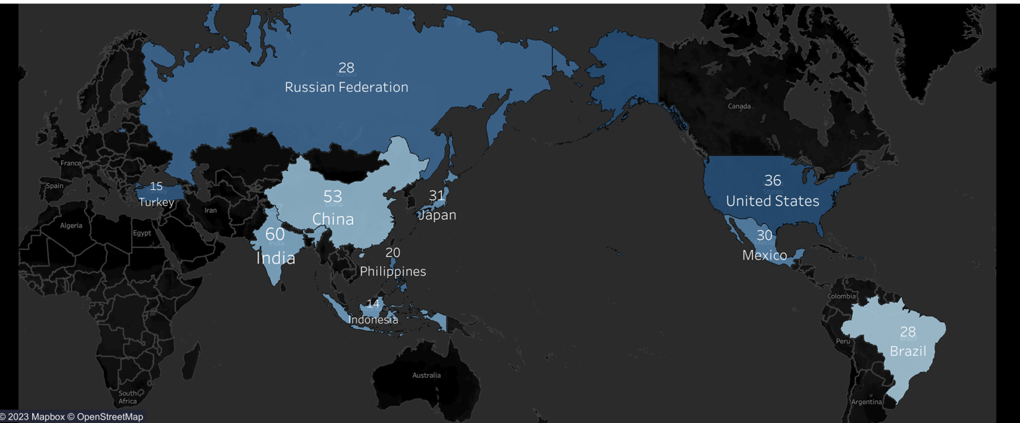
Top 10 countries where customers are based
The top 10 countries are: India, China, United States, Japan, Mexico, Russian Federation, Brazil, Philippines, Indonesia, Turkey

Slide 10
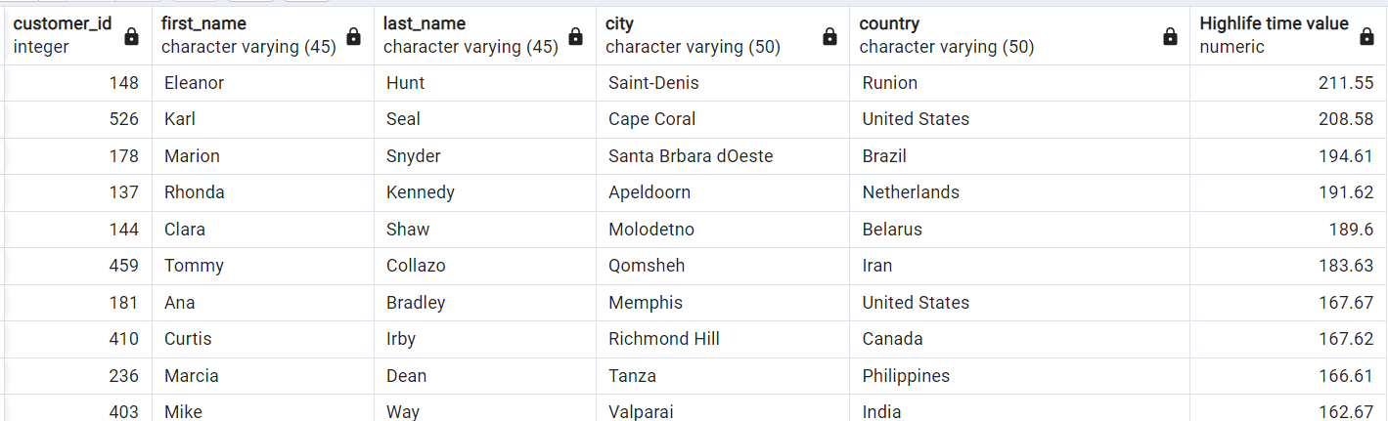
Where are customers with a high lifetime value based
It is obvious Eleanor Hunt fromSaint_Denis in Reunion contributed greatly to the company revenue.

Slide 11
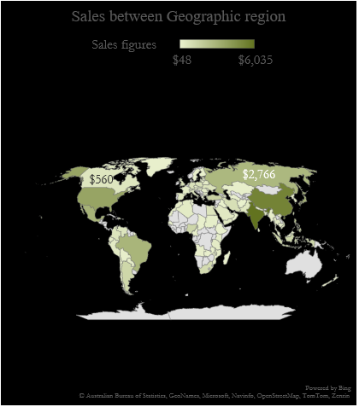
Do sales figures vary between geographic regions
From the Map, It is obvious that Asia has the highest sales being the darkest color.
Sales across geographic regions;
Asia has the largest sales follow by North America while the third is South America, next to it is Europe and Africa has the least sales according to the Map.

Slide 12
Summary
Top 5 countries where Rockbuster customers lives are: India, China, US, Japan and Mexico. In this group, India has the highest sales revenue 0f $ 6,035.
Customer with highlife time value lives in a country different from the top 5 except for US and they are: Runion, US, Brazil, Netherland and Belanus.
Asia has the highest sales revenue follow by North America, South America, Europe and Africa respectively.
Top 5 movie with highest revenue are: Telegraph Voyage, Zorro Ark, Wife turn, Innocent Usual and Hustler party.

Slide 13
Recommendation
I would suggest that Rockbuster should continue to expand in their strong markets India and China especially since Netflix and Amazon get more of their customers from United states
Introduce more incentives to their loyal customer with highlife time value in Runion, United States, Brazil, Netherlands and Belarus.
I would also suggest continuous focus on the top 5 movie that generates more revenue in order to have more profits (Telegraph Voyage, Zorro Ark, Wife turn, Innocent usual and Hussler party etc)
Tableau link: 3.10 SQL Findings | Tableau Public

Slide 14
THANK YOU
Emmanuel Eniade
eniade.emmanuel@gmail.com

